Slide 1
Datacove Dataset Analysis Task
Sam Marine
27/05/2025

Slide 2
Approach
Overarching questions:
What insights can I provide to the client?
How can I address the client’s goals?
Top-down analysis
Demographics: provide better understanding of customers
Products: what do customers prefer
Rating: customer satisfaction
Create human readable results
Stats are important, but conveying them is more important

Slide 3
Assumptions
Company is a relatively sizable online retailer
The company is UK based, so the unit of currency is pounds/pence
Cancelled orders result in no revenue
Rating represents the customer’s satisfaction with the product, with no other factors
Rating scores are an integer between 1–5, no decimals

Slide 4
Software
Language: R (version 4.4.3)
Data manipulation: Tidyverse (version 2.0.0) and data.table (version 1.17.0)
Graphing: ggplot (version 3.5.2)

Slide 5
Customer Demographics
12,136 customers bought 73,650 products over 20,000 total orders
Gender split: 50.82% men, 49.18% women
The average customer spent £5240.83
They bought 9.04 items over 1.65 orders
5,941 (48.95%) customers made 2 or more orders
The average order costed £3180.13, and consisted of 5.49 items
Action
Encourage repeat purchases
Increasing the number of items customers buy is the best way to increase revenue
Increasing price is mostly to be avoided

Slide 6
Loyalty Programme
21.71% were loyalty members
Loyalty members have no recognisable demographic
No significant change in ratings, repeat purchases or spending
The average loyalty member made 1.13 orders
The average non-loyalty member made 1.48
Action
If the loyalty scheme offers points, provide more rewards to spend them on
Incentivise repeated shopping

Slide 7
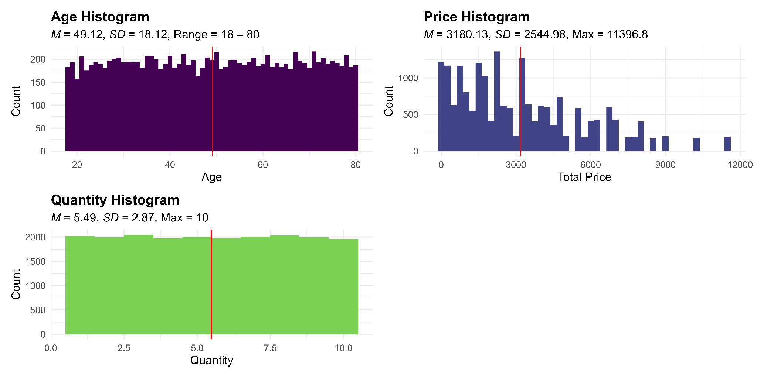

Slide 8
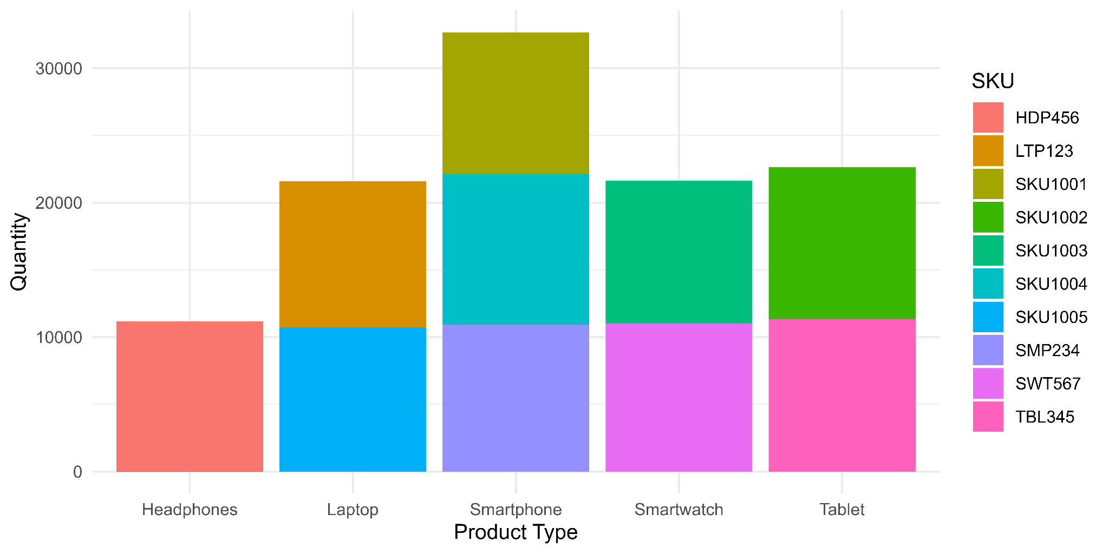
Products

Slide 9
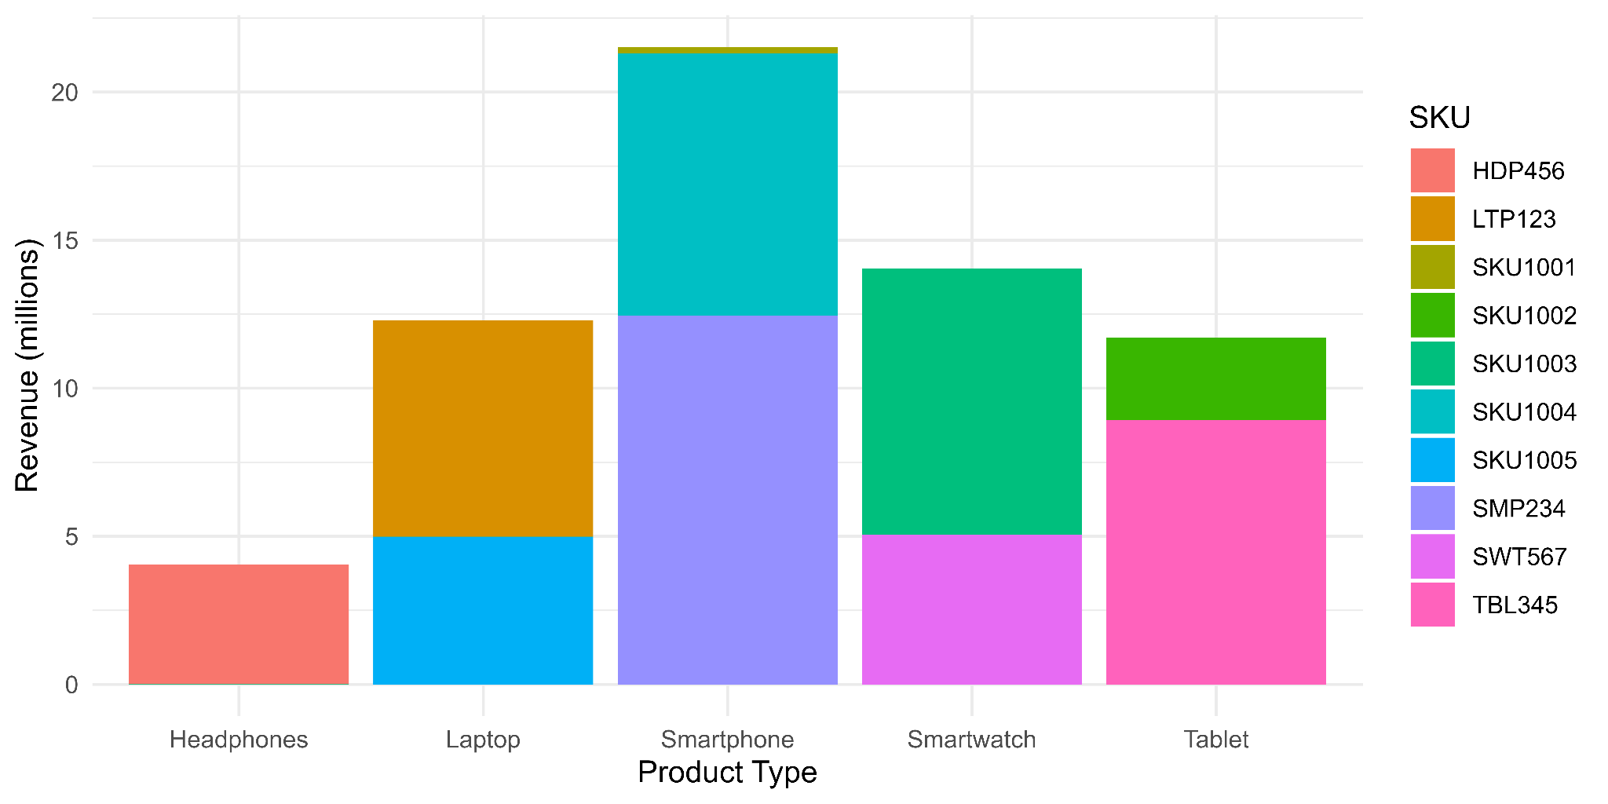
Total revenue from completed orders was 42,629,616

Slide 10
Products
Product Type | Revenue | % Revenue | Units sold | % units sold | Mean revenue per sale
Headphones | 2,734,651 | 6.41% | 7,565 | 6.89% | 361.49
Laptop | 8,365,905 | 19.62% | 14,623 | 13.33% | 572.11
Smartphone | 14,407,836 | 33.80% | 21,947 | 20.00% | 656.48
Smartwatch | 9,398,591 | 22.05% | 14,474 | 13.19% | 649.34
Tablet | 7,722,632 | 18.11% | 15,041 | 13.71% | 513.43
Total | 42,629,616 |  | 73,650
Smartphones are the most cost effective product type
Best selling, and generate the most revenue

Slide 11
Cancellations
Around 33% of all orders were cancelled
Amazon recommends that sellers maintain a <2.5% cancellation rate¹
The revenue lost from cancelled orders was £20,973,053 (32.3% of potential revenue)
No recognisable demographics
Action
Offer incentives to dissuade cancelling orders
Present customers that cancel with a questionnaire
¹https://sellercentral.amazon.co.uk/help/hub/reference/external/G200285210

Slide 12
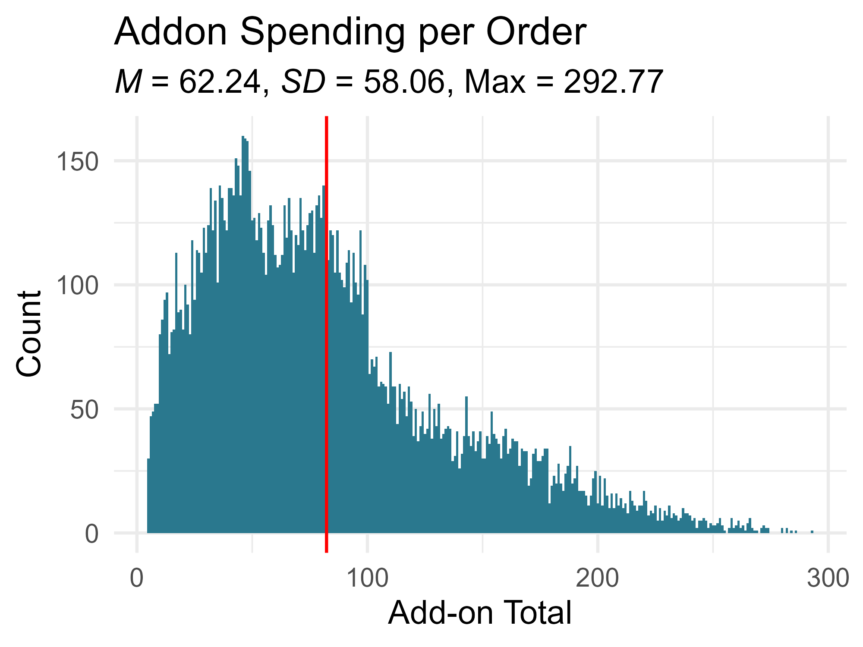
Addons
Total revenue from addons was £1,244,897
3% of total revenue
24% of customers bought no addons
No identifiable demographic

Slide 13
Addons
Addon Type | Quantity Sold
Impulse Item | 10,234
Accessory | 10,048
Extended Warranty | 9,975
Total | 30,257
Impulse Items sold the best
Action
On-site advertising
Discounted bundles

Slide 14
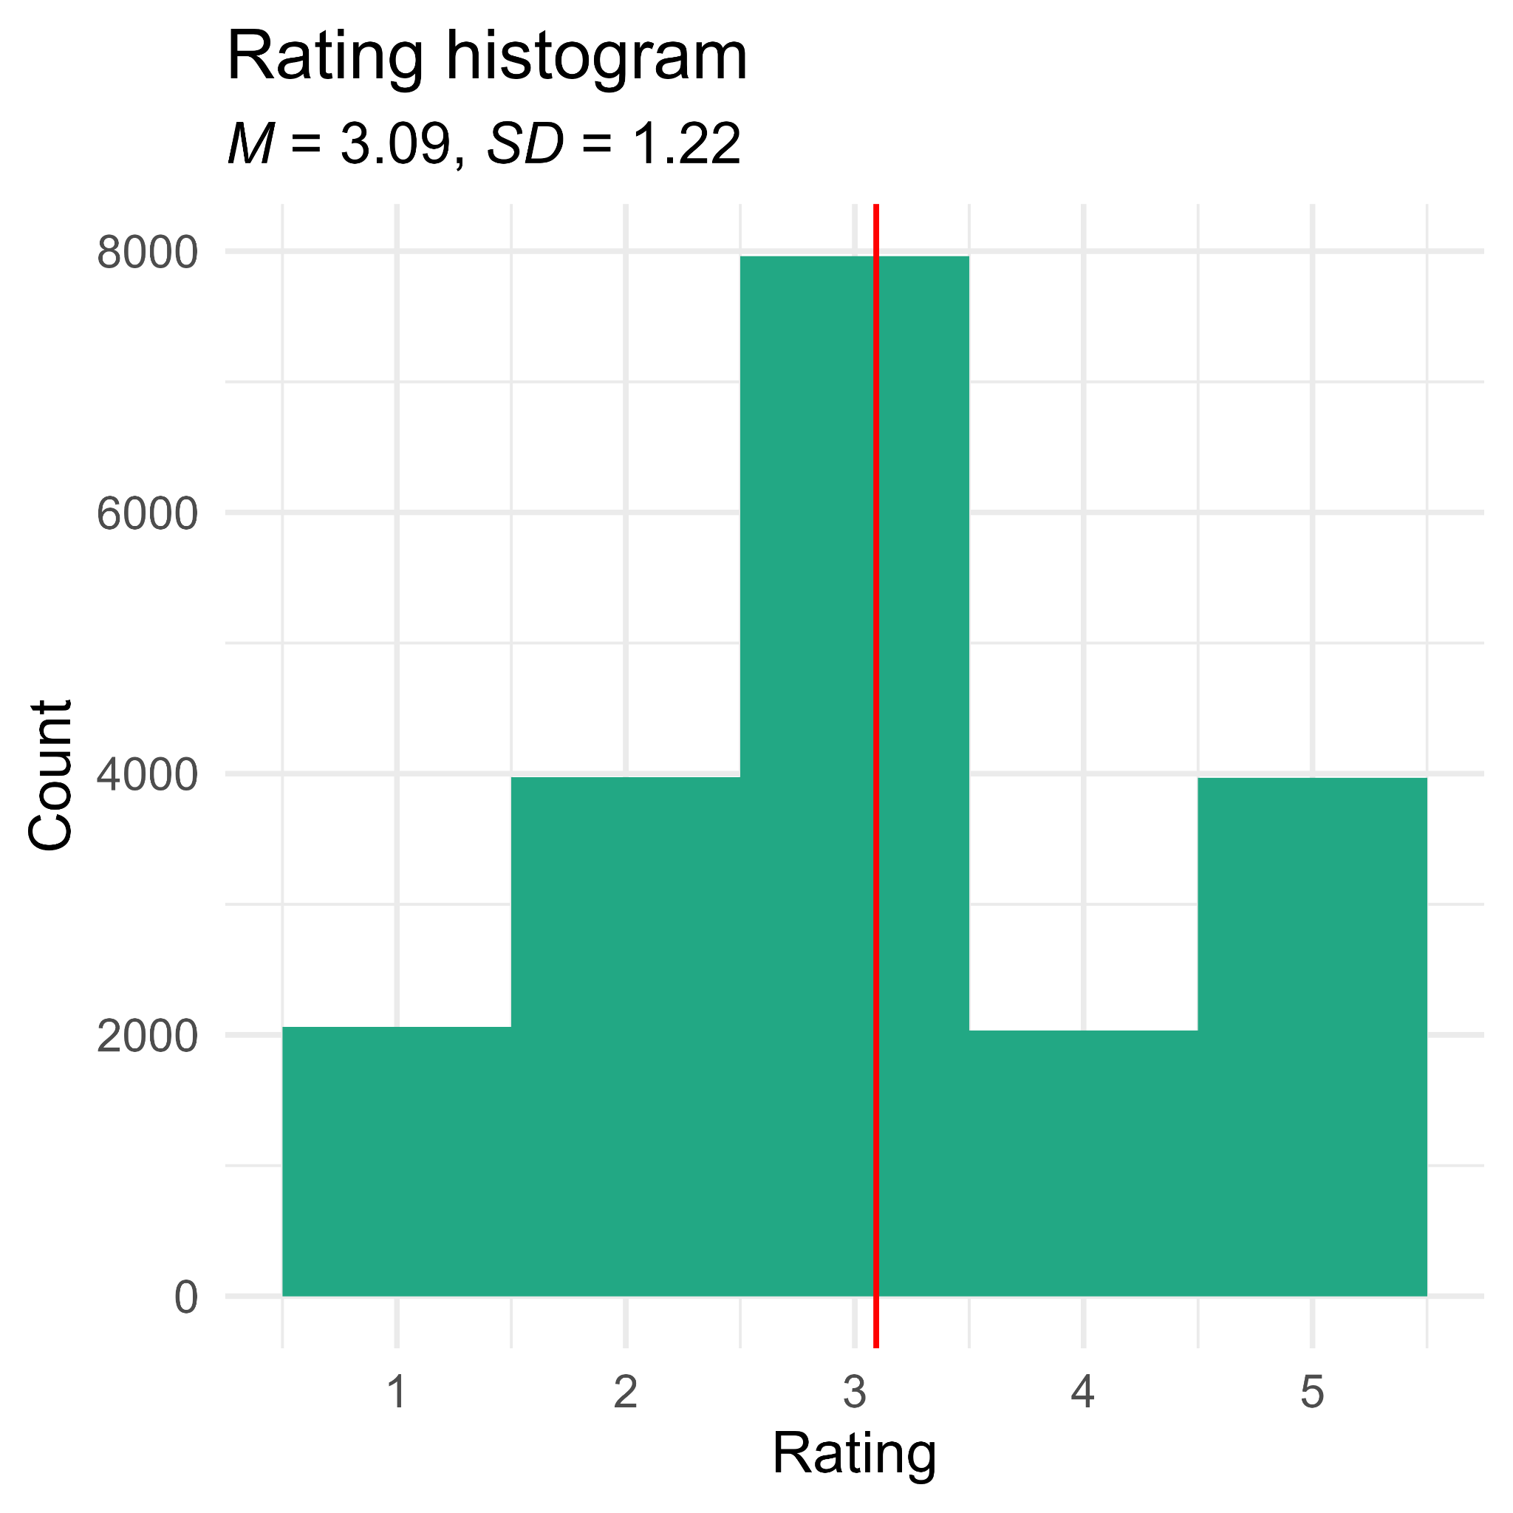
Rating
The main measure of customer satisfaction
Attempted many visualisations and analyses
Analyses
Highest rated product/product type
Rating as a function of order price

Slide 15
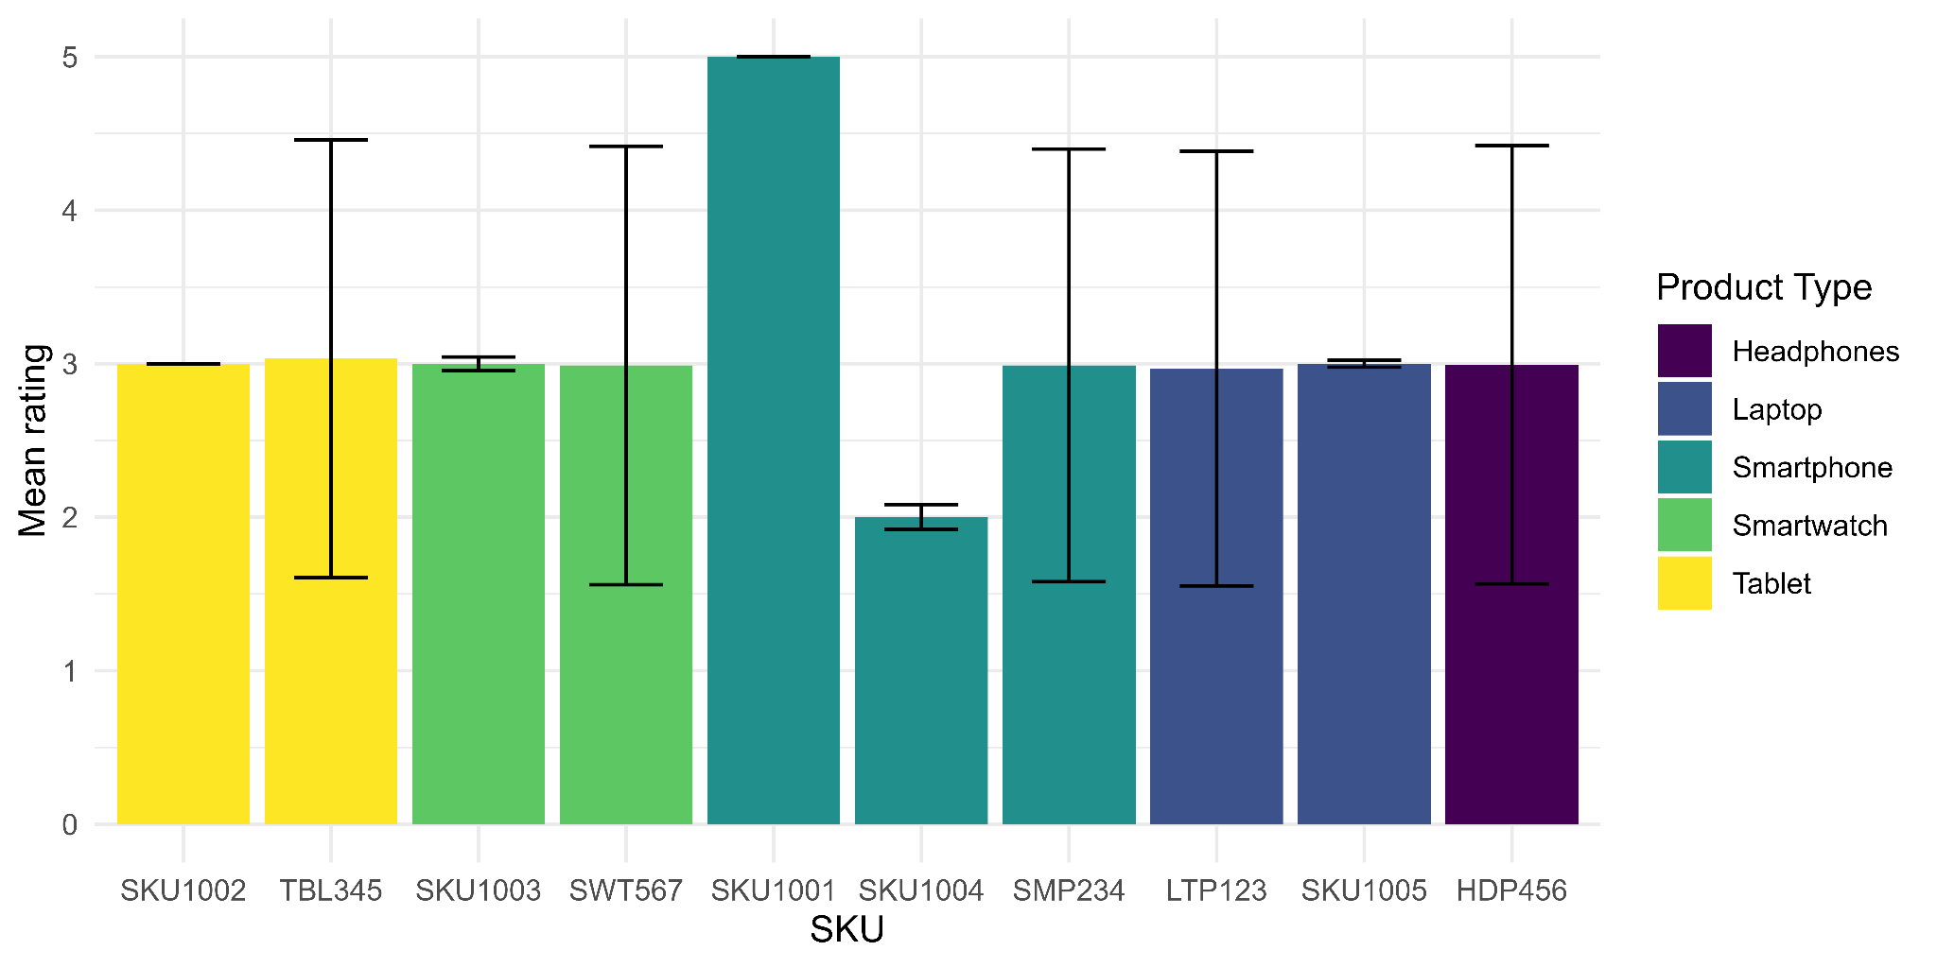
(Each product sold very similar amounts)

Slide 16
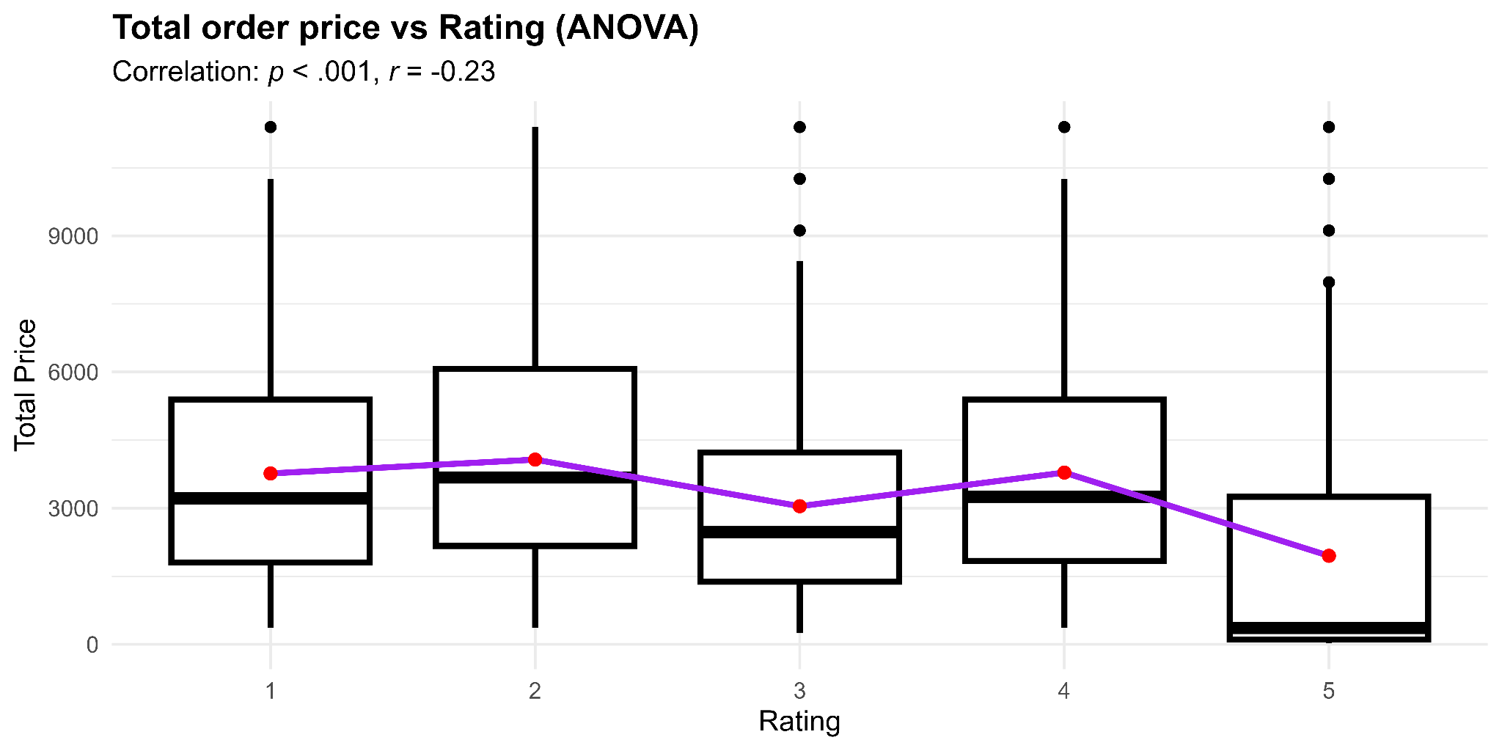
F(1, 19998) = 1142, p < .001, β = -483.3666, CI 95% = [-511.4021, -455.3312]
Increasing rating decreases the mean order price by £483.37

Slide 17
ANOVA conclusions
Questionable model fit
R²: 0.05, very small
Therefore, limited predictive power
The displayed pattern may still be reasonable: lower prices may mean higher ratings
This model is “reversed”, looking at mean price as a function of rating, not the opposite
Action
Strive towards lowering prices to improve customer satisfaction

Slide 18
Conclusions
Around half of customers only make one order
Improve the loyalty programme
Addons make up a very small proportion of revenue
Increase promotion or sell bundles
All products sell roughly the same quantity
The majority are rated similarly
Smartphones are the best selling, best rated, and most cost efficient product type
Best product type to push for increased sales

Slide 19
Conclusions
A massive proportion of orders are cancelled, leading to large losses of revenue
Provide discounts when cancelling, or collect the reason for cancelling
Reducing prices may increase ratings and product satisfaction

